Slide 1
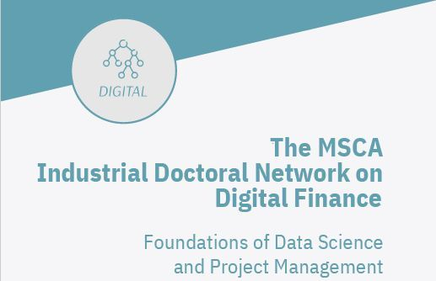

Foundations of Data Science
– Beyond the Basics
Liana Stanca & Codruța Mare
FSEGA,UBB, Cluj-Napoca

Slide 2
According to C. S. Lewis:
"We do not teach what we know, but what we have become through what we know."
"This course is an invitation to a conversation that began long before and will continue long after the presentation ends."
"Good courses are built over time - from ideas read, tested, and re-understood."

Slide 3
Individual work
Please answer the following questions on a sheet of paper.
Where are you from?
In which field are you conducting research?
What is the title of your doctoral thesis?
What are the research hypotheses?
What is data science?
What do you know about data science?
How does data science help with the subject of your research?
Where do you get your data from?
What is the first step in your research?
How can you make it possible for everyone to see what you have written on paper?
In 15 minutes, make it possible for everyone to see what you have written on the paper.

Slide 4
Data Science
Artificial Intelligence
Machine Learning
Deep Learning

Slide 5
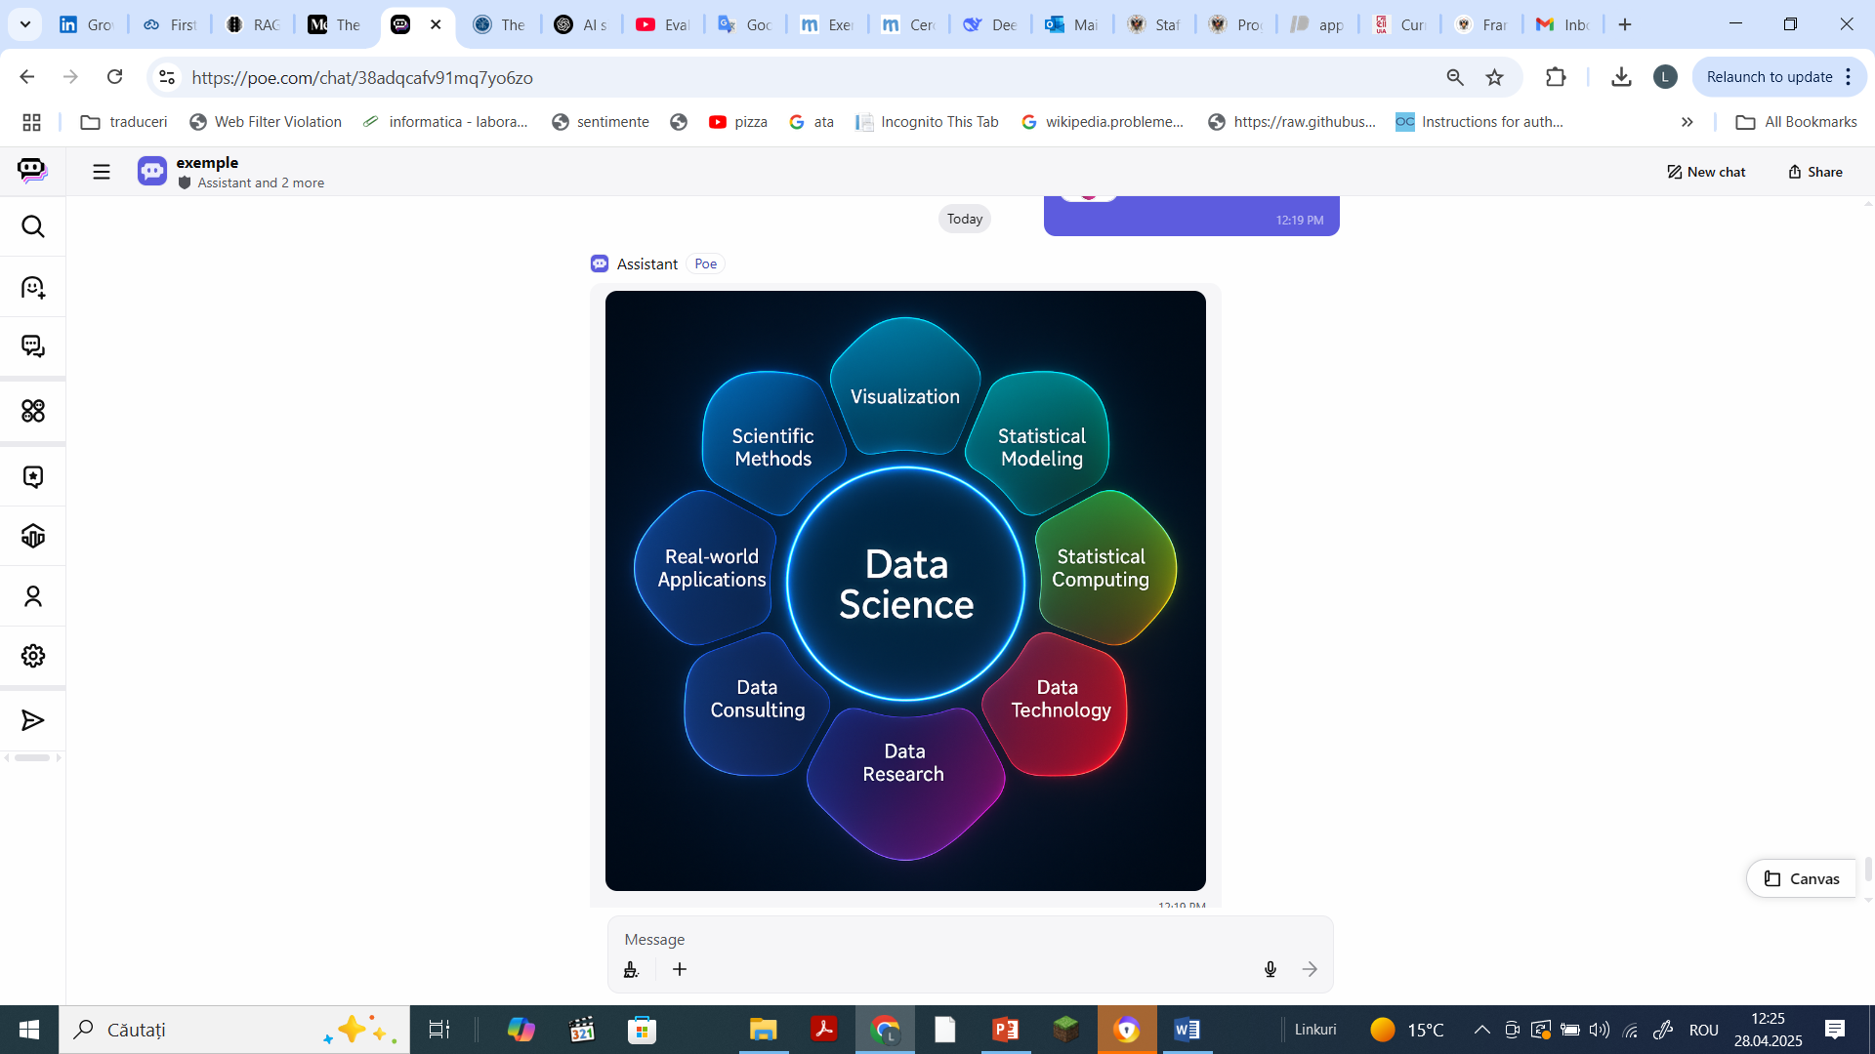
Data Science
is an interdisciplinary field that combines
Maths, Computing, Data Engineering, Machine Learning, and Domain Expertise — form the foundation of data science.
Mastery of these areas enables us to navigate the complexities of modern data and drive innovation across disciplines.

Slide 6
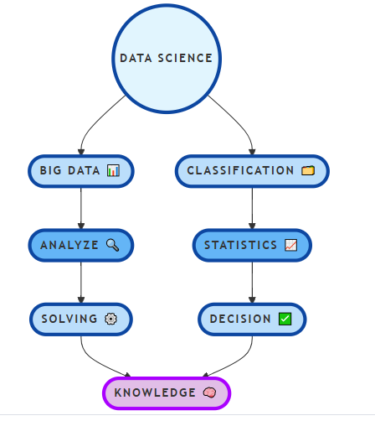
The Complete Data Science Roadmap

Slide 7
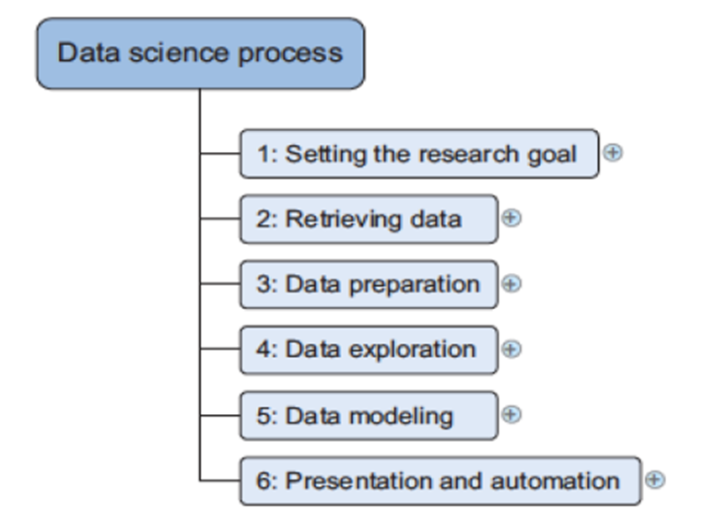
Data science process

Slide 8
Descriptive Analyses
in Data Science

Slide 9
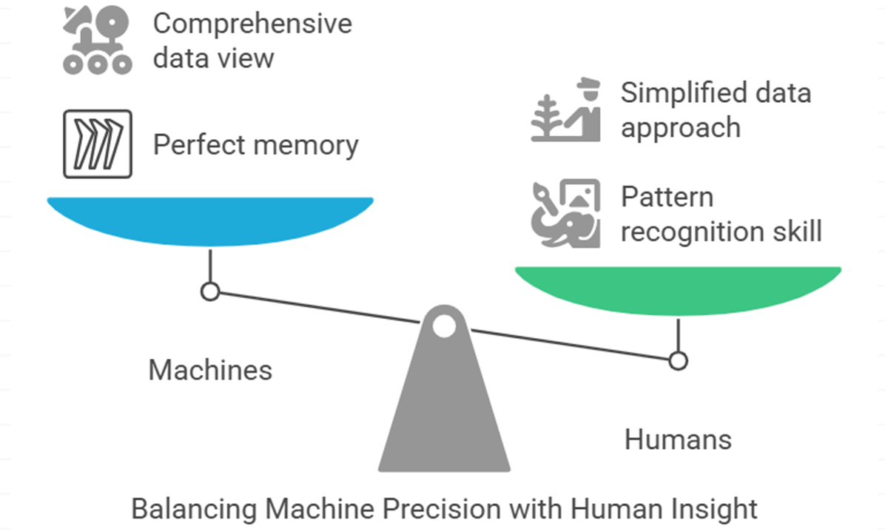

Slide 10
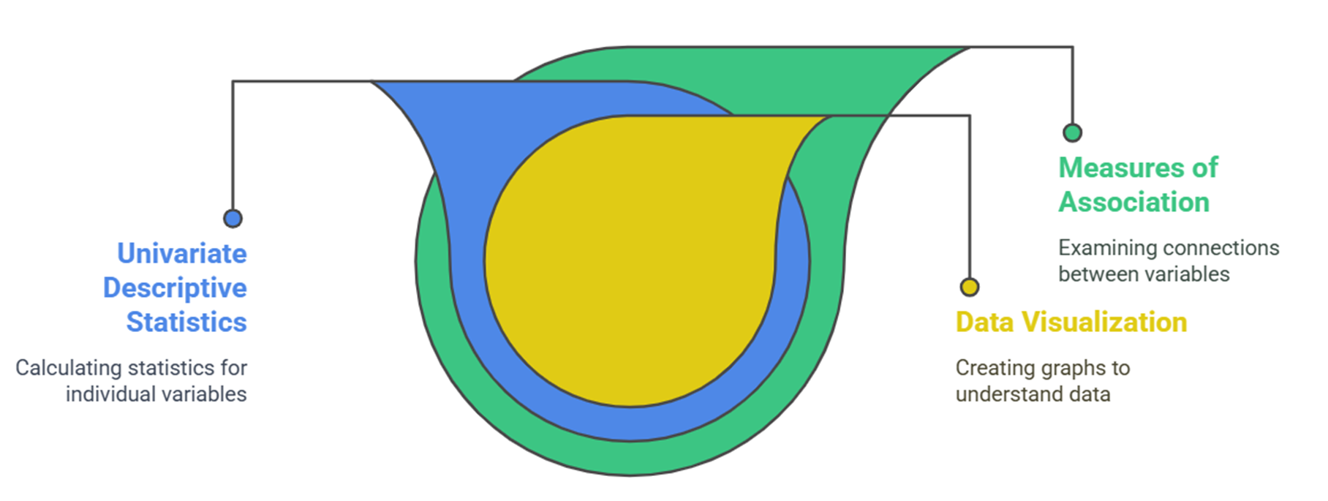
Steps in Descriptive Statistics

Slide 11
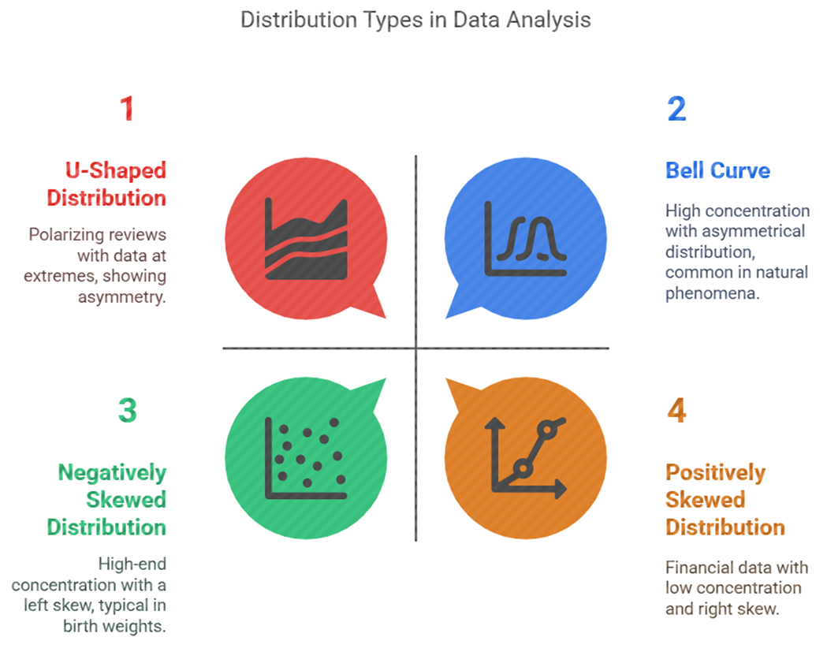
Visualizing Your Data

Slide 12
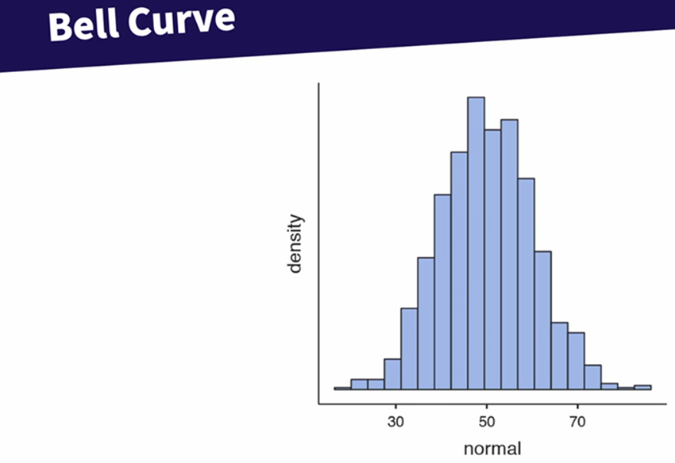
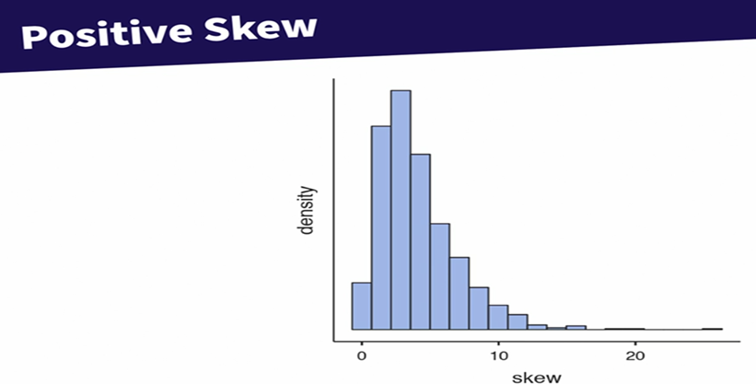
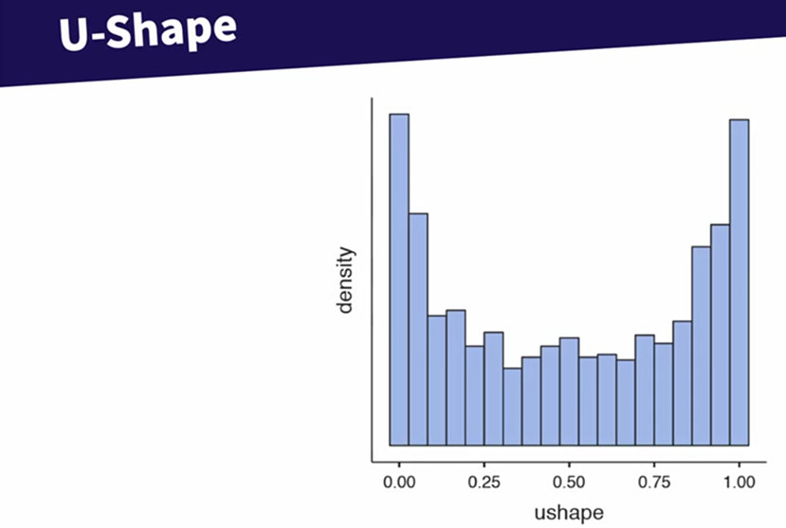
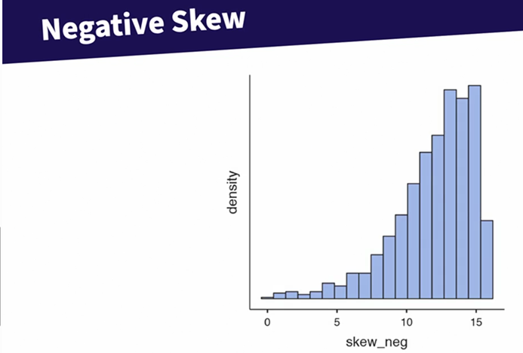

Slide 13
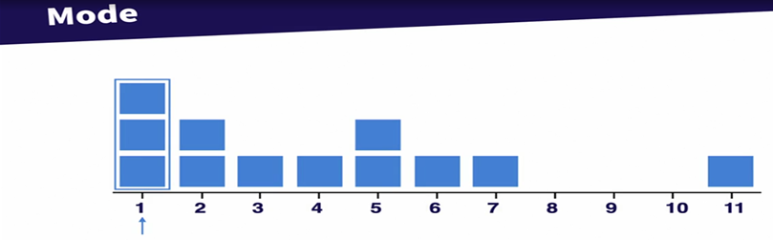
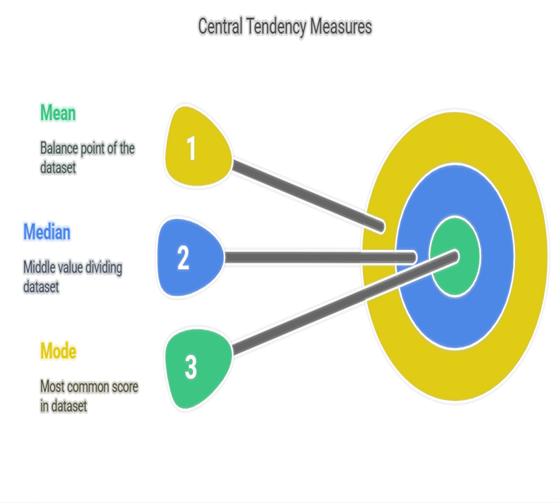
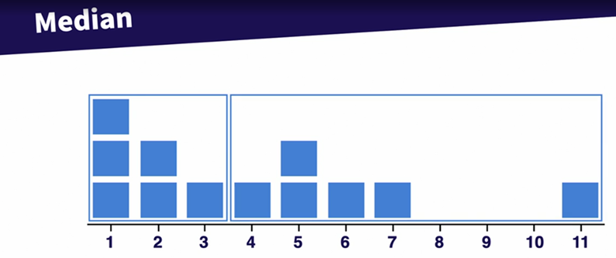
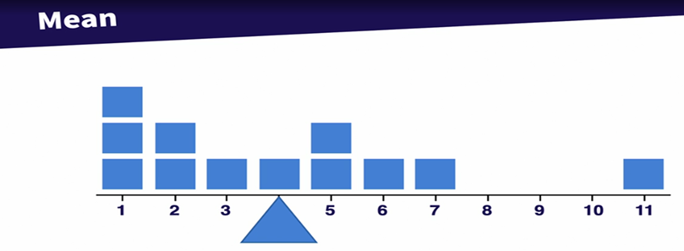
Common Univariate Descriptive Statistics

Slide 14
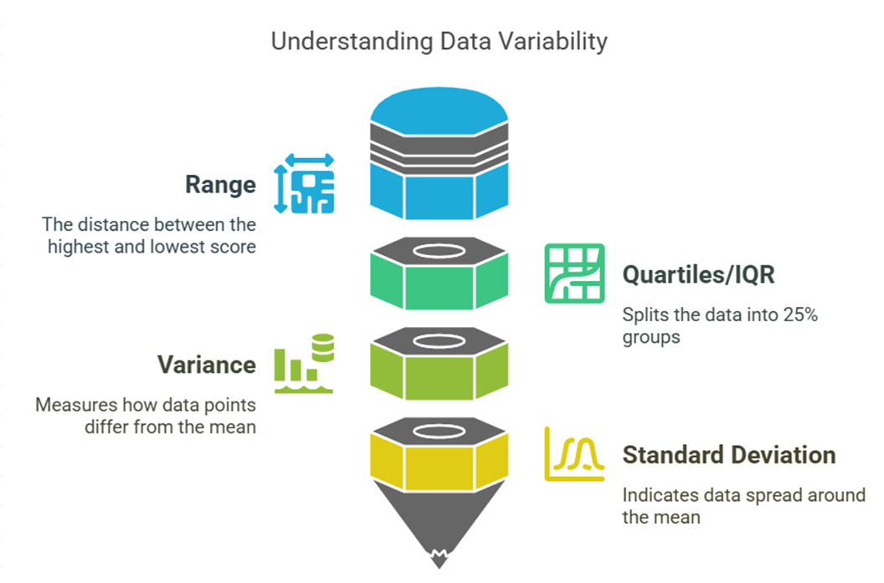
Measures of Variability

Slide 15
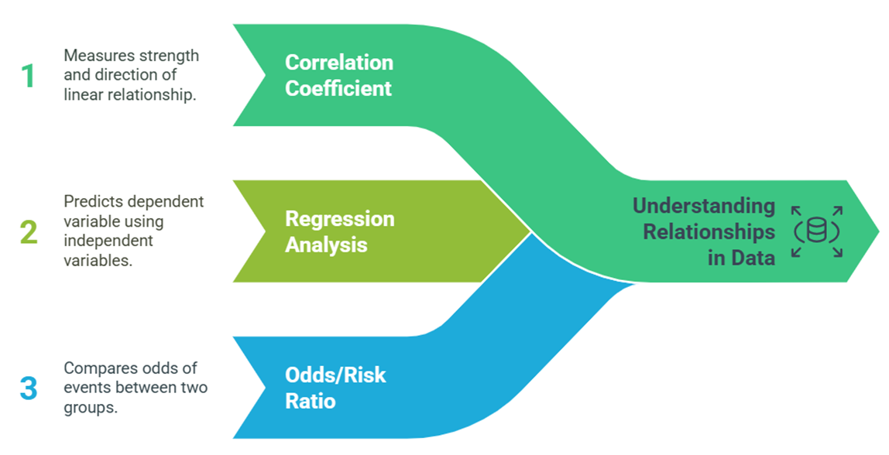
Analyzing Associations

Slide 16
Data Preparation and Management in Finance
1. Identifying and Handling Missing Data
Detection: Identify rows or columns with missing values (NaN).
Solutions:
Remove rows or columns with too many missing values.
Replace missing values with:
Mean, median, or mode.
Estimated values (interpolation).
A constant value.
2. Removing Duplicates
Duplicates can occur during data extraction or merging.
Solution:
Use functions like drop_duplicates() to remove duplicate rows.
4. Handling Outliers
Identify values that are far outside the normal range.
Solutions:
Remove or adjust outliers.
Use statistical methods like:
5. Standardizing and Normalizing Data
Standardization:
Transform data to have a mean of 0 and a standard deviation of 1.
Normalization:
Scale data between 0 and 1.
6. Transforming and Encoding Data
Categorical Data: Convert categorical variables into numerical ones using:
One-Hot Encoding.
Label Encoding.
Date/Time Data:
Extract features like the day of the week, month, year, etc.
7. Aggregating and Reducing Dimensionality
For large datasets:
Aggregate data (e.g., daily or weekly averages).
Use methods like PCA (Principal Component Analysis) to reduce dimensionality.
3. Checking and Fixing Data Types
Ensure each column has the correct data type:
Numeric: int, float.
Text: string.
Date/Time: datetime.
IQR (Interquartile Range).
Z-scores.

Slide 17
Data modelling

Slide 18
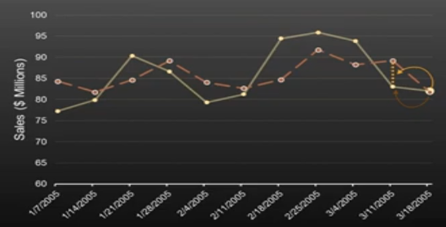
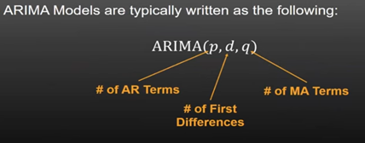
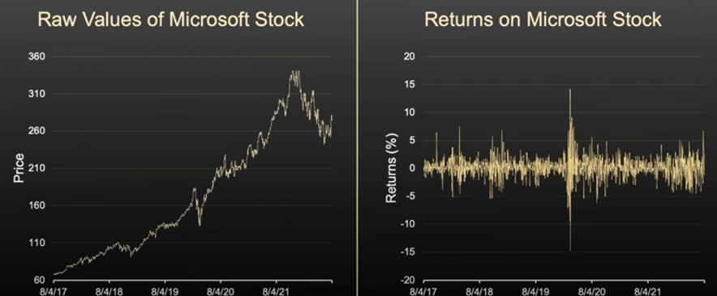
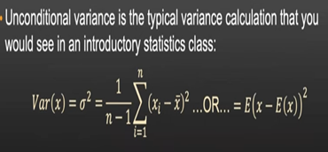
Statistical Methods and Financial Econometrics
ARIMA => to understand and predict future values,
Useful for business planning, inventory, and resource allocation.
Model future values ​​by:
AR: The relationship between a value and its previous values.
I: Making the series stationary (by differentiating).
MA: Errors in previous predictions.
Example: Monthly sales forecasts in a store.
GARCH (Generalized Autoregressive Conditional Heteroskedasticity)
Models the volatility (variability) of data.
Useful for:
Estimating financial risks.
Pricing options and financial derivatives.
Example: Daily volatility of stock prices.

Slide 19
Machine Learning - SL (1)
Supervised Learning=Predicts continuous variables
Classification: Predicts categorical outcomes. For instance, classifying emails as spam or not spam. Key algorithms include:
Logistic Regression: Fits a sigmoid function to estimate the probability of a class.
K-Nearest Neighbors (KNN): assigns a class based on the majority class of the K closest data points. K is a hyperparameter.
Support Vector Machine (SVM): finds a decision boundary (hyperplane) that maximizes the margin between classes, using kernel functions for complex boundaries.
Naive Bayes: uses Bayes’ theorem to classify based on word probabilities, commonly used in spam filters.
Decision Trees: splits data into branches based on features to create "pure" leaf nodes. These are foundational for ensemble methods like:
Random Forests: Combines multiple decision trees using bagging to improve robustness and prevent overfitting.
Boosting: Sequentially trains models to correct errors of previous ones (e.g., AdaBoost, Gradient Boosting, XGBoost).

Slide 20
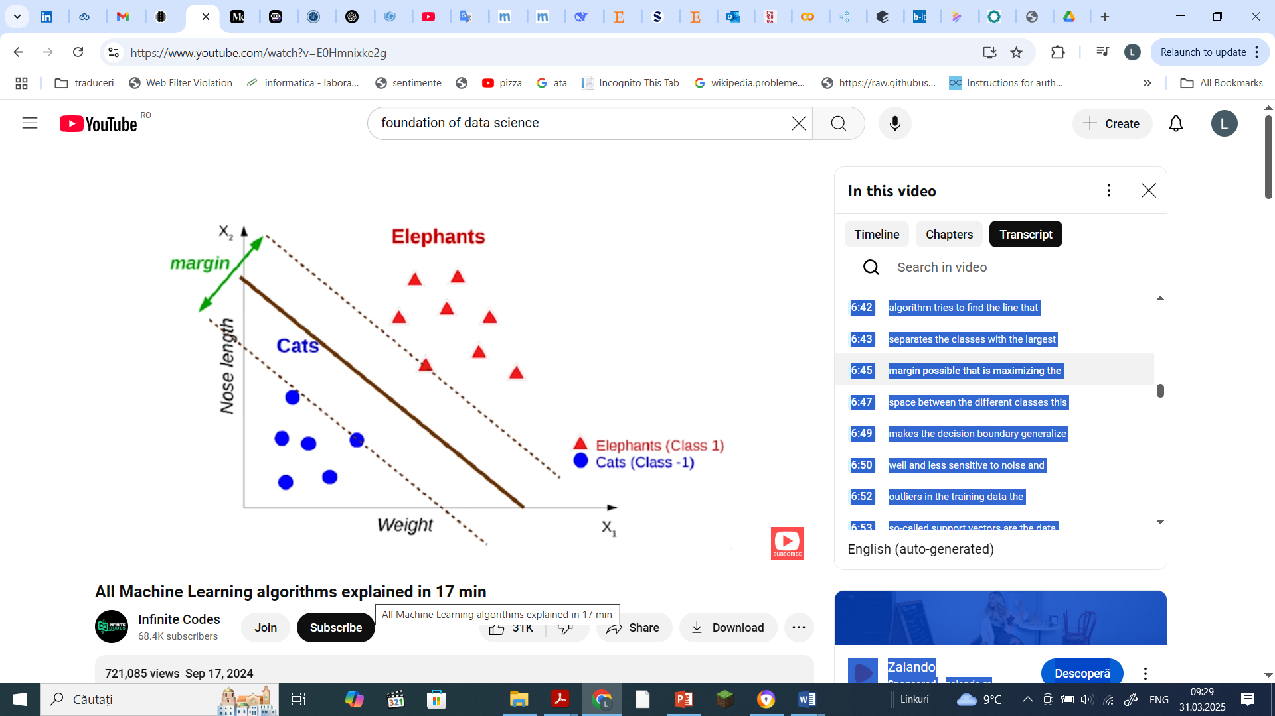
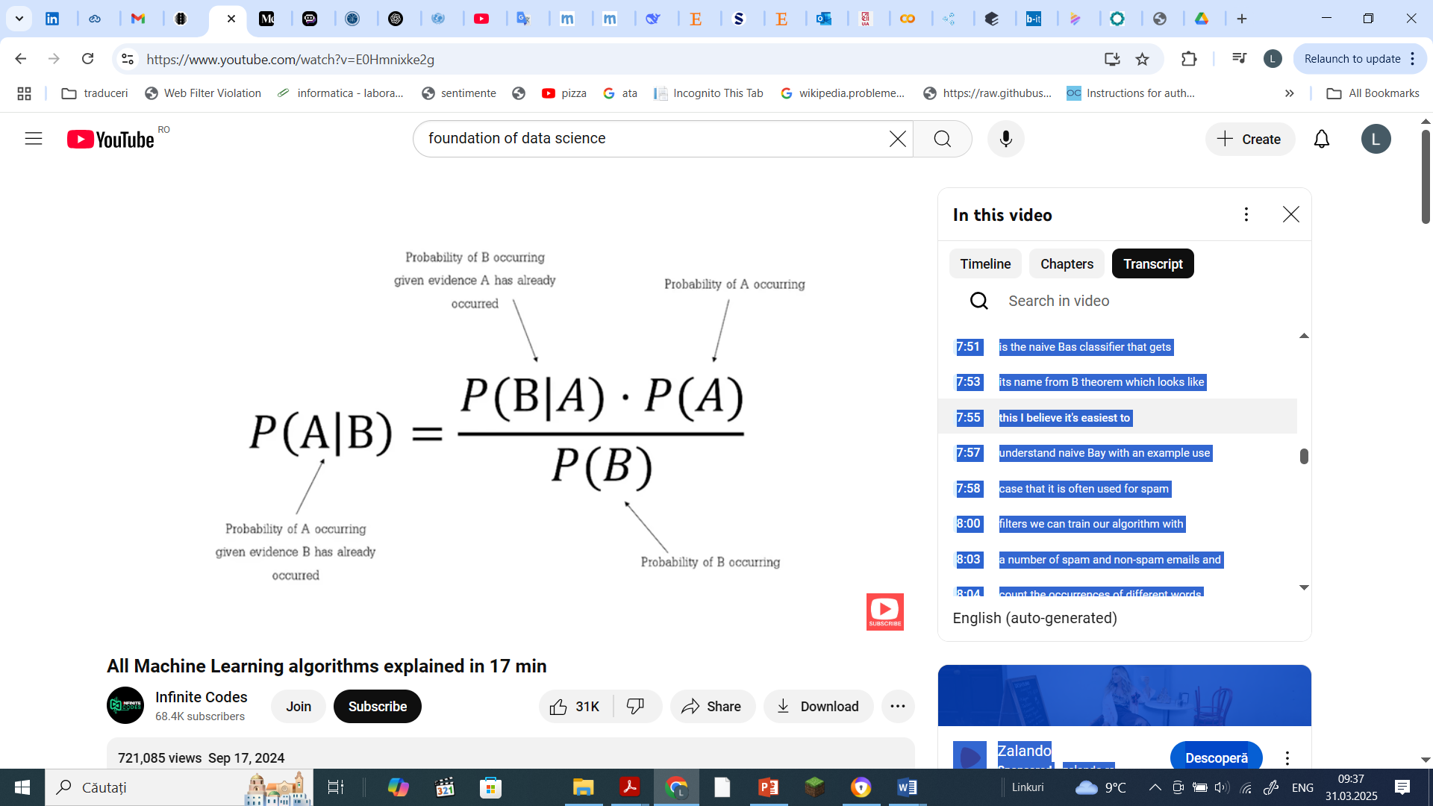
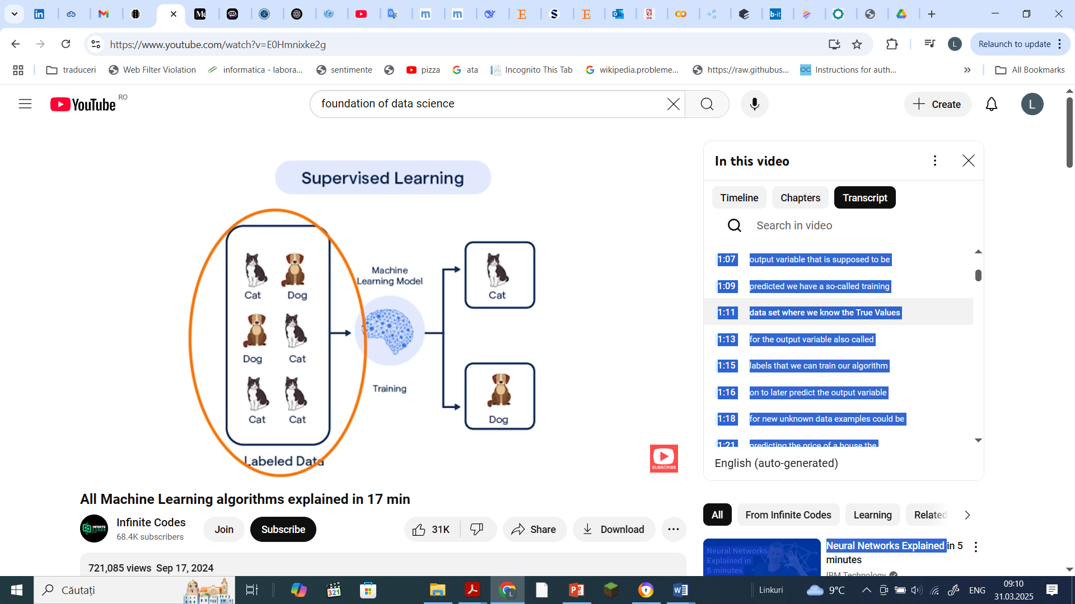
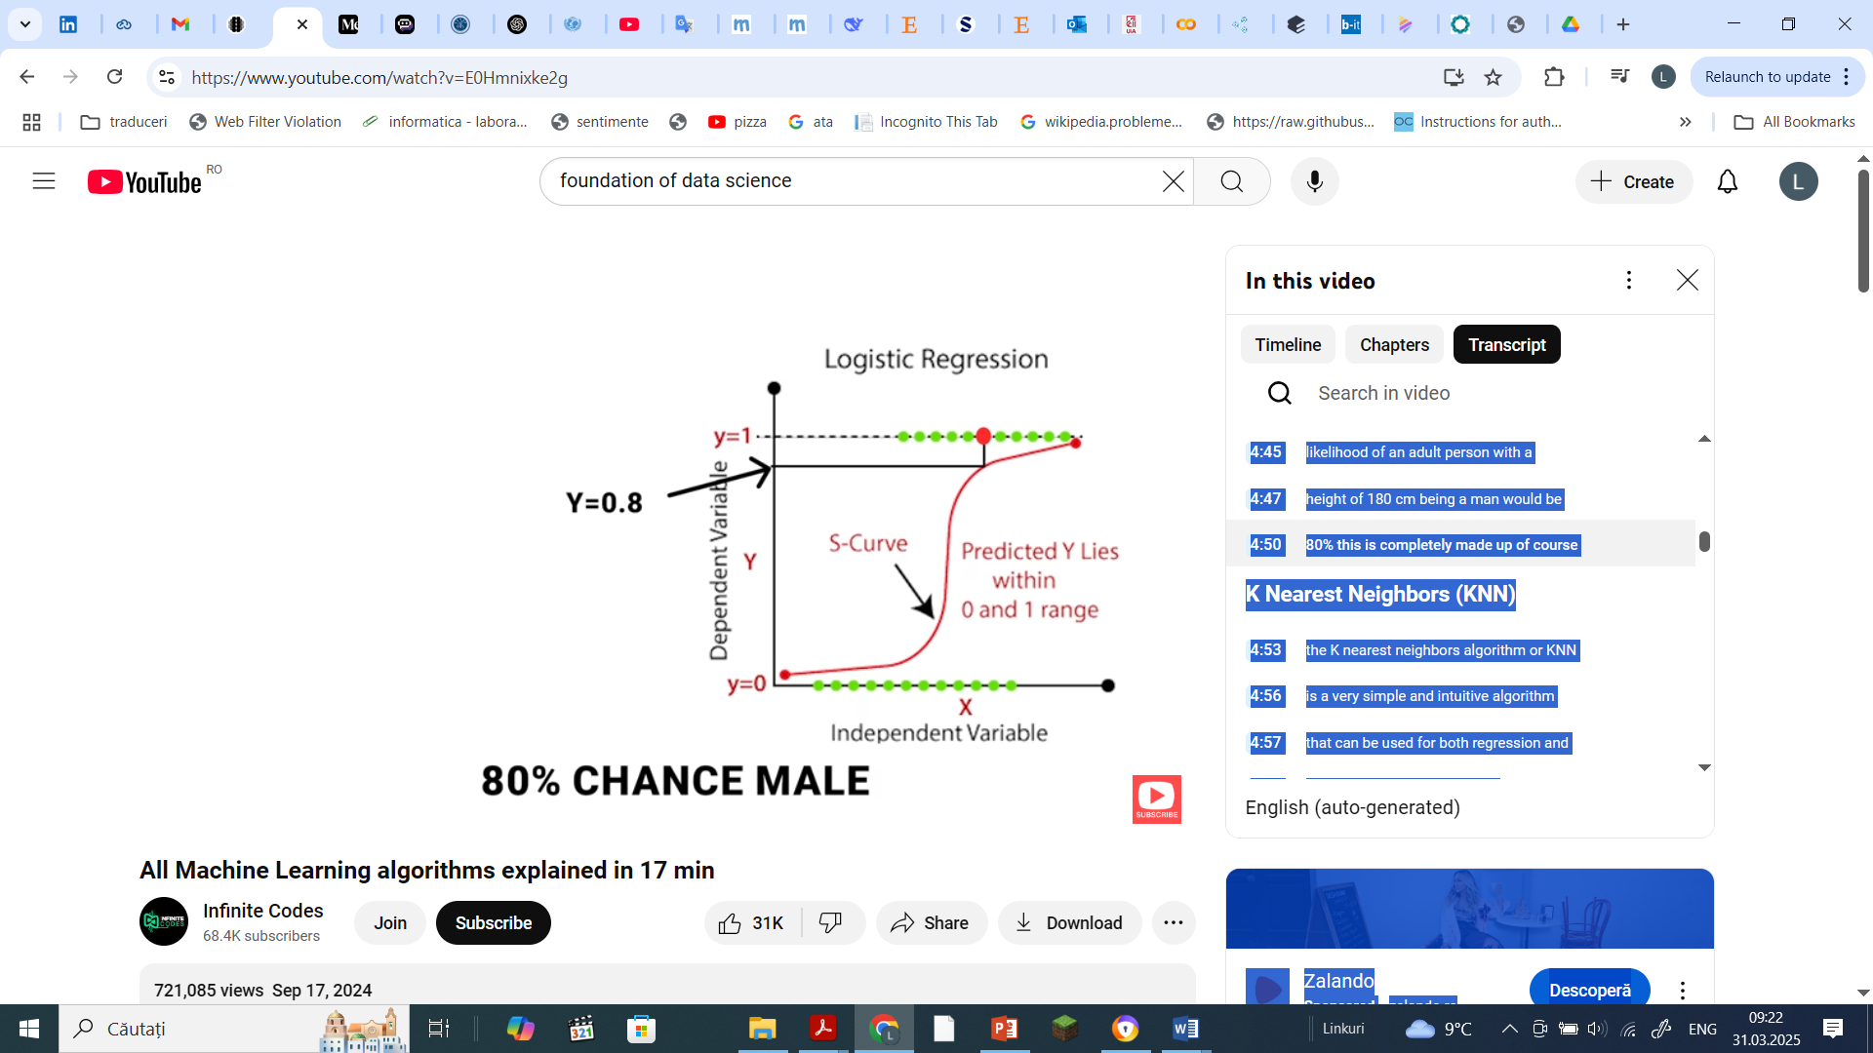

Machine Learning - SL (2)
Regression + Classification Task
Non-Parametric Alg
Classification + Regression Task

Slide 21
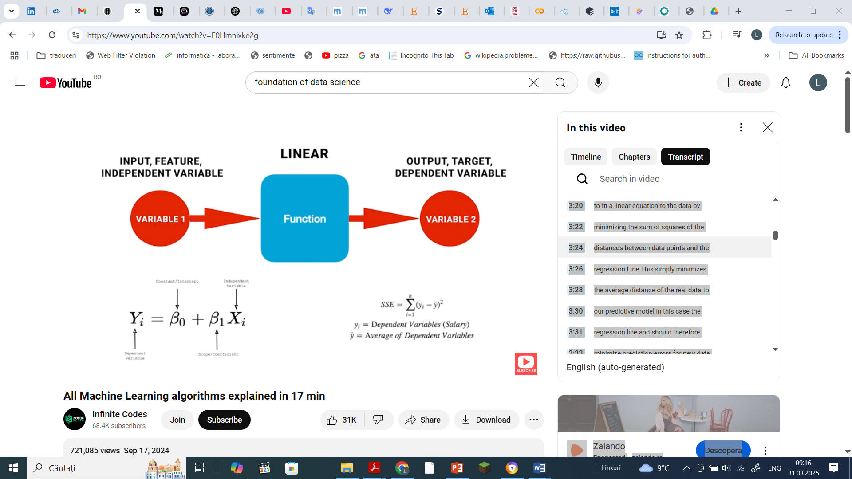
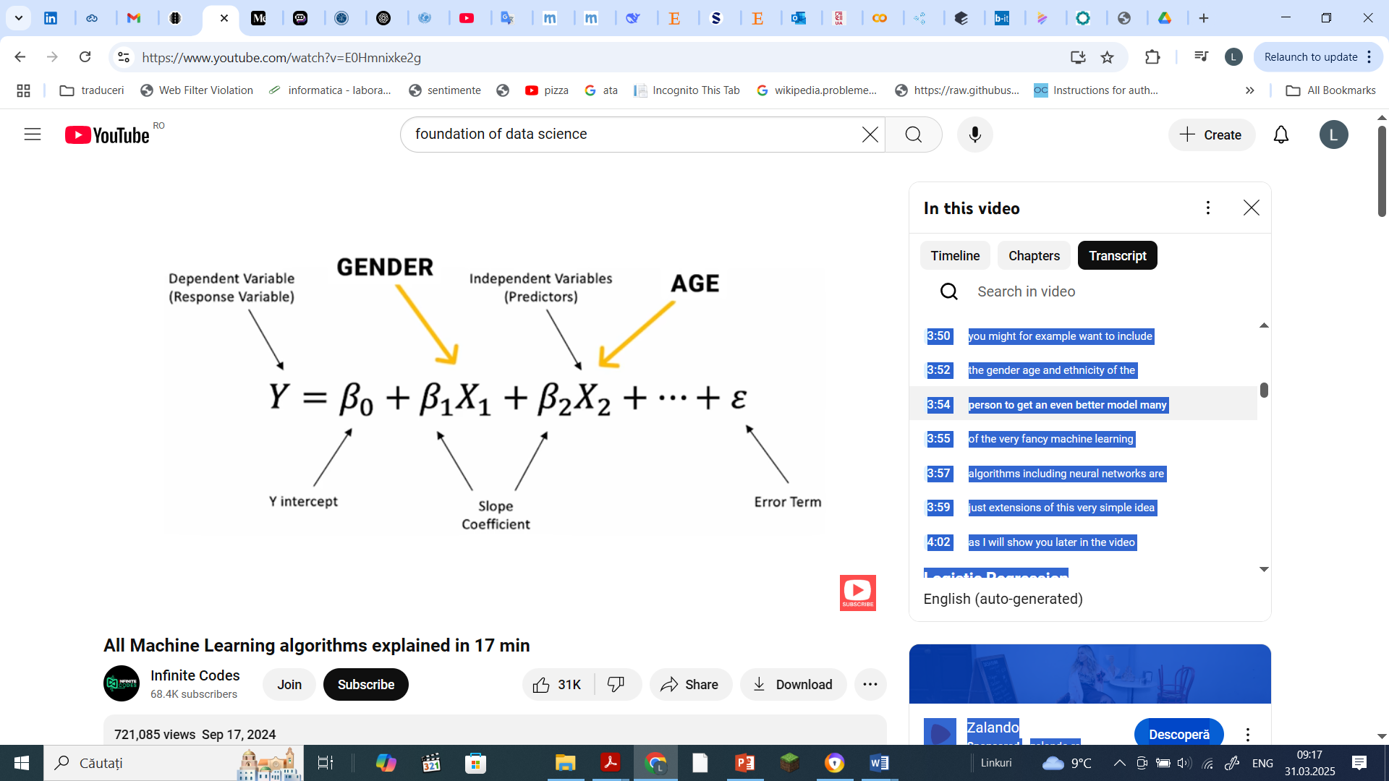
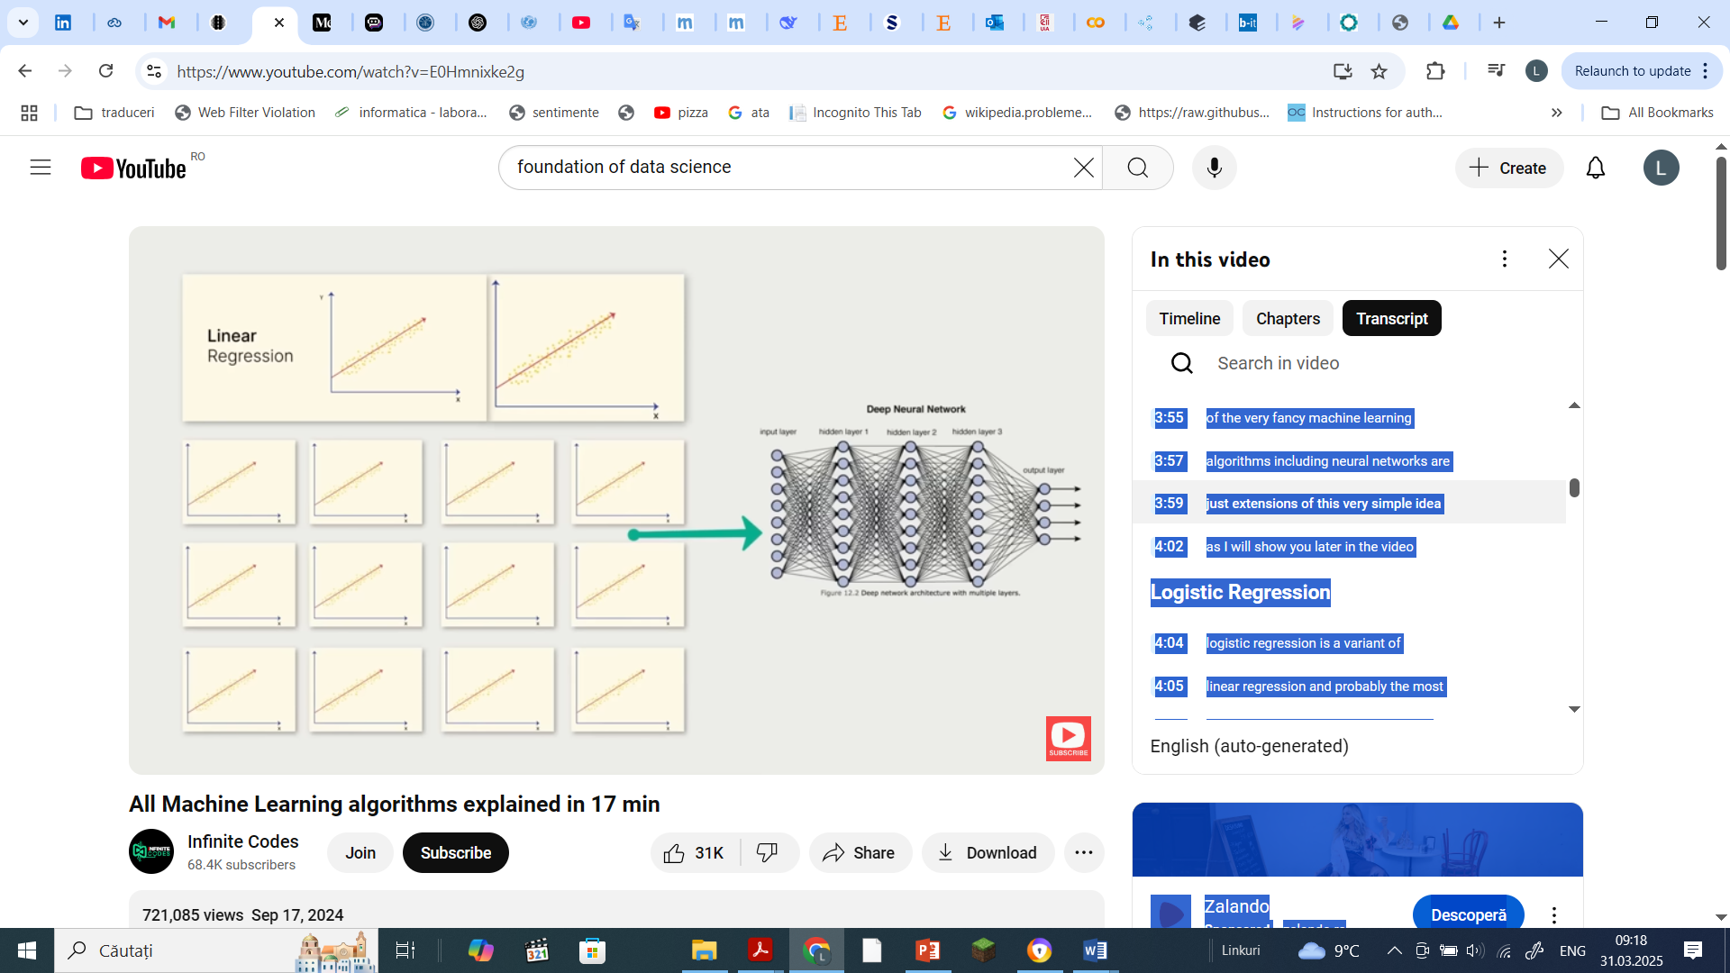
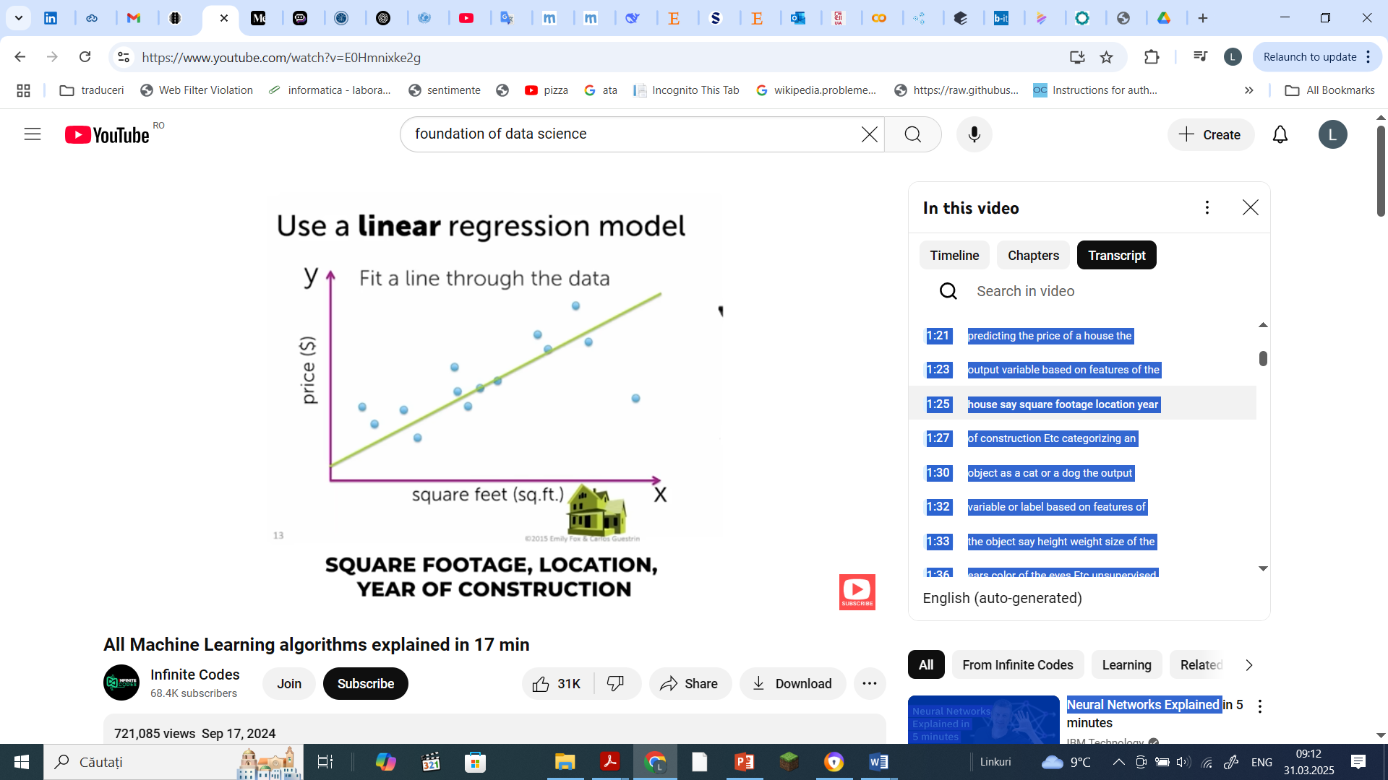
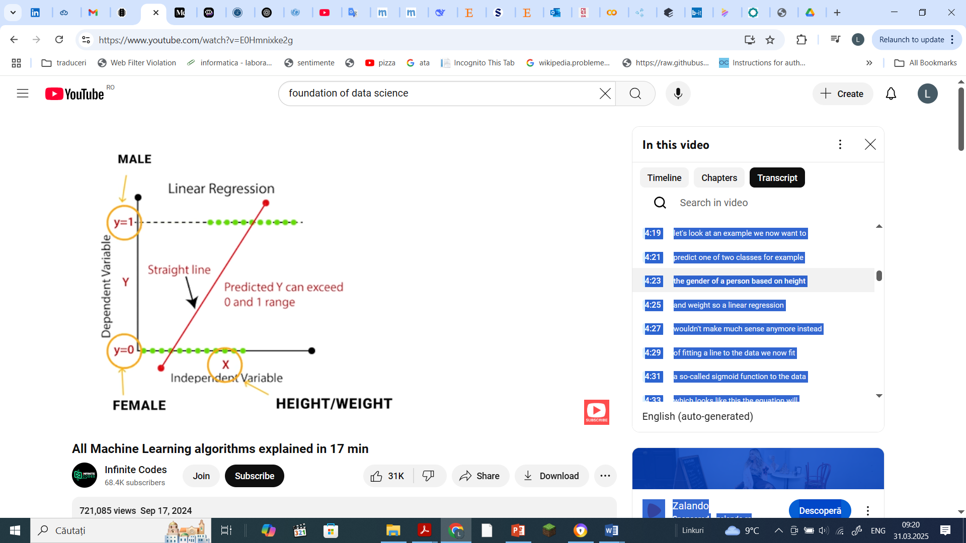
Machine Learning - SL (3)
Regression + Classification Task

Slide 22
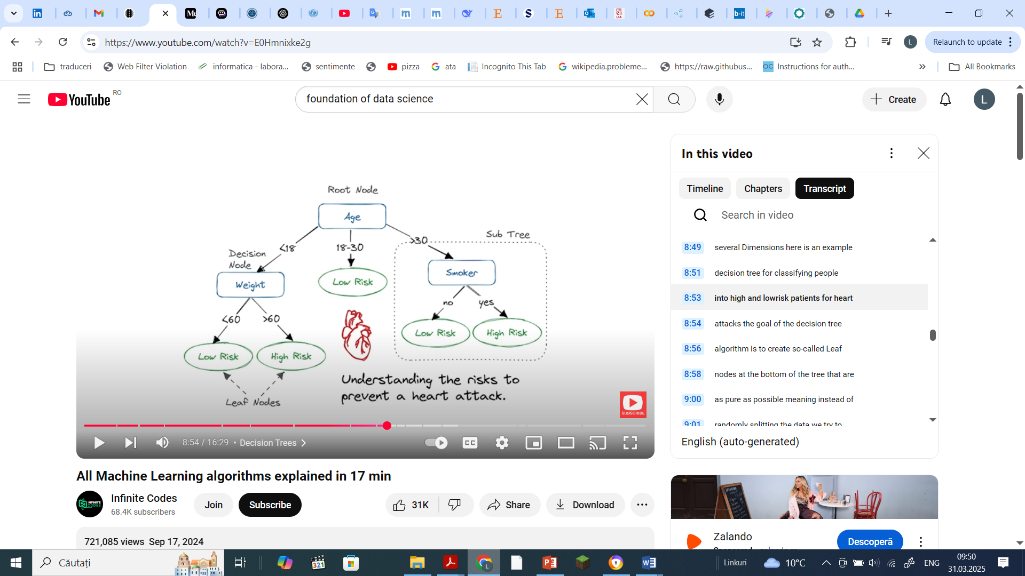
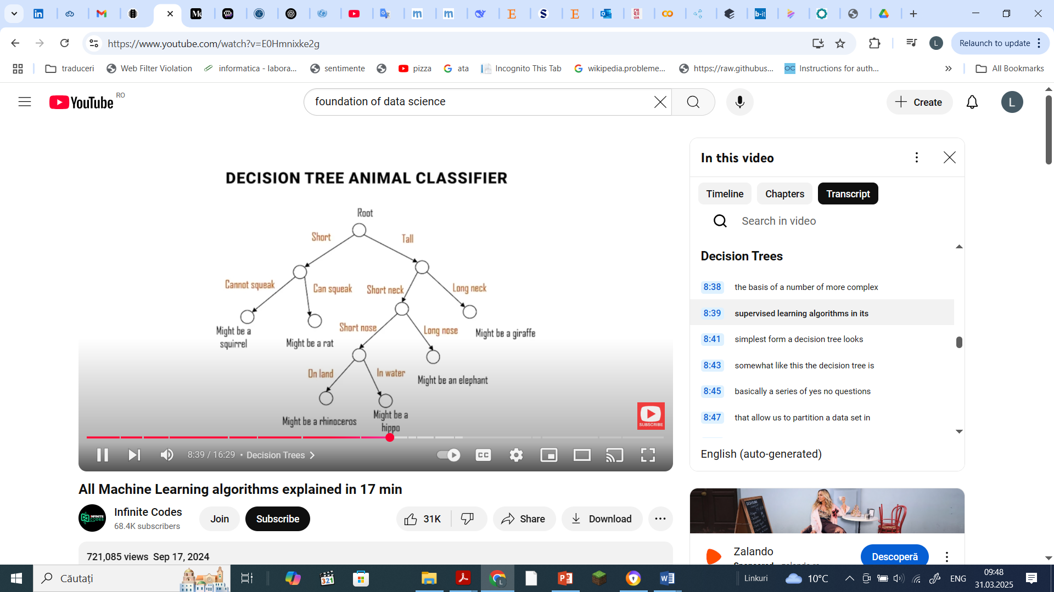
Machine Learning - SL (4)
Classification Task + Regression

Slide 23
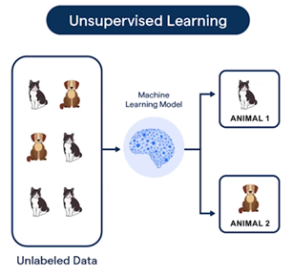
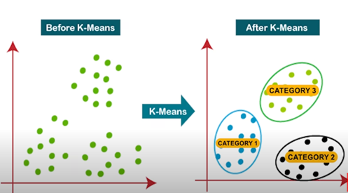
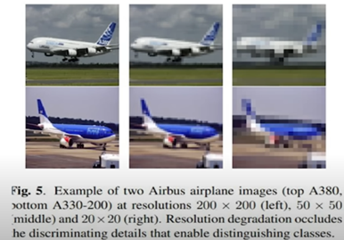
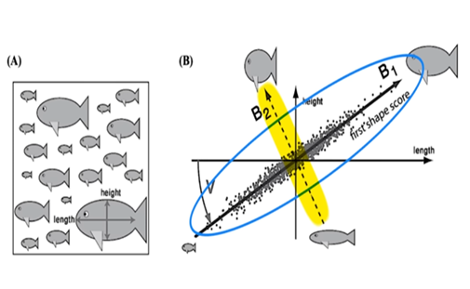
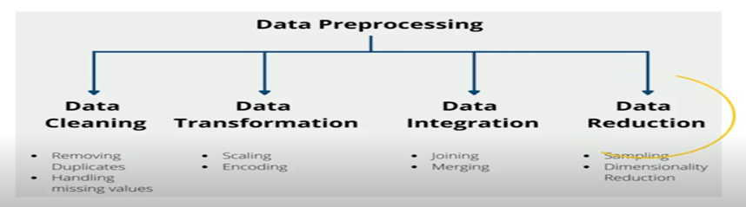

Machine Learning - USL
Unsupervised Learning= discovering patterns in unlabeled data
Clustering: groups data based on similarity without predefined labels. Example algorithms:
K-Means: divides data into K clusters by iteratively recalculating cluster centers.
DBSCAN and Hierarchical Clustering: Identify clusters of arbitrary shapes.
Dimensionality Reduction: Reduces the number of features while retaining important information. Example:
Principal Component Analysis (PCA): Finds directions (principal components) that explain most data variance, helping to remove redundant features.
Notes:
Unsupervised LearningUnsupervised learning is different from supervised learning because, in unsupervised learning, we don’t aim to predict a specific target variable. Instead, the focus is on discovering the underlying structure in the data. One of the most common unsupervised learning problems is clustering.
It’s important to distinguish between classification and clustering. Classification is used when we know the classes we want to predict and have labeled training data to guide the model. For example, we may have images of cats and dogs with labels to train the model. In contrast, clustering is used when we don’t have labels. Instead, we aim to identify unknown clusters within the dataset by analyzing its structure.
For instance, in a two-dimensional dataset, humans might easily identify clusters visually. However, in more complex datasets, the number of clusters isn’t immediately apparent, and this is where algorithms come into play.
The most famous clustering algorithm is K-means clustering. In K-means, "K" represents the number of clusters we want to find. Choosing the correct number of clusters often involves domain knowledge and trial and error. The algorithm works as follows:
Start by randomly selecting K cluster centers.
Assign each data point to the nearest cluster center.
Recalculate the cluster centers based on the assigned data points.
Reassign the data points to the new cluster centers.
Repeat this process until the cluster centers stabilize.
While K-means is a widely used algorithm, it has limitations, such as requiring the number of clusters to be specified upfront. Other clustering algorithms, like hierarchical clustering and DBSCAN, don’t require the number of clusters to be predefined and can detect clusters of arbitrary shapes.
In summary, clustering helps identify hidden patterns in data without requiring labeled examples, making it a powerful tool for uncovering insights in complex datasets.
SO
Clustering: Groups data based on similarity without predefined labels. Example algorithms:
K-Means: Divides data into K clusters by iteratively recalculating cluster centers.
DBSCAN and Hierarchical Clustering: Identify clusters of arbitrary shapes.
Dimensionality Reduction: Reduces the number of features while retaining important information. Example:
Principal Component Analysis (PCA): Finds directions (principal components) that explain most data variance, helping to remove redundant features.
Dimensionality reduction is the process of reducing the number of features or dimensions in a dataset while retaining as much information as possible. These algorithms typically achieve this by identifying correlations between existing features and removing redundant dimensions without losing important information.
For instance, consider an image. Do you really need a high-resolution picture to recognize an airplane, or can you reduce the number of pixels while still identifying the airplane? Dimensionality reduction helps uncover relationships between features and can also be used as a preprocessing step in supervised learning to make algorithms more efficient and robust.
One popular dimensionality reduction algorithm is Principal Component Analysis (PCA). Let’s say we are trying to predict types of fish based on features like length, height, color, and number of teeth. By analyzing the correlations, we might discover that height and length are strongly correlated. Including both features may not add much value and could even introduce noise. Instead, we could create a single shape feature that combines height and length. This approach is common in large datasets and allows for substantial dimensionality reduction while maintaining performance.
PCA works by finding the directions in which the dataset retains the most variance. These directions are called principal components. For example, the first principal component is the direction with the most variance in the data and can replace multiple correlated features. The second principal component is orthogonal to the first and explains less variance. In large datasets, we can rank all principal components by how much variance they explain and exclude those that contribute little to the dataset’s variability. This reduces the number of features while preserving the essential structure of the data.
Dimensionality reduction, particularly through PCA, is a powerful tool for simplifying datasets, eliminating redundancy, and improving the robustness of machine learning models.
Neural Networks and Deep Learning

Slide 24
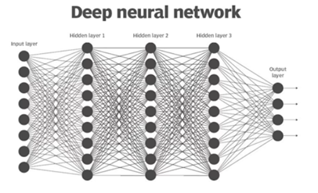
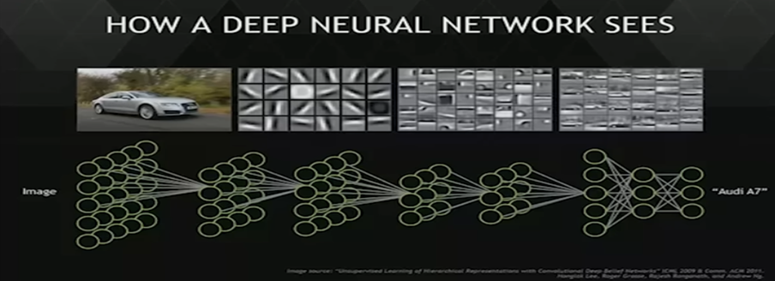
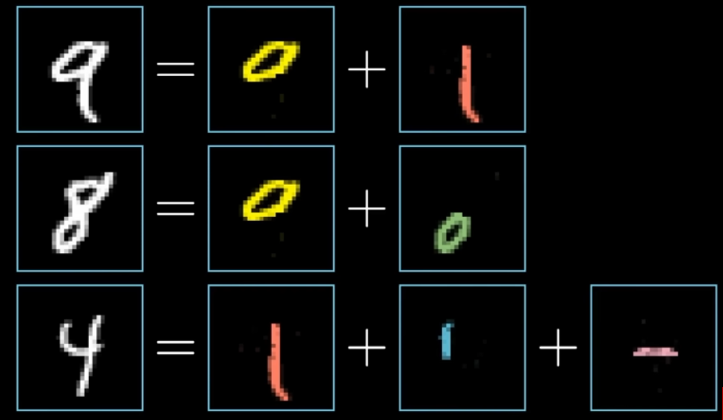
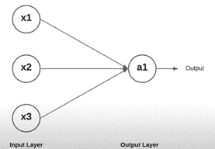
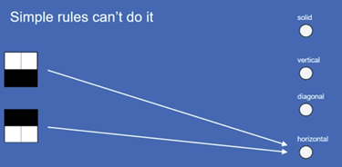
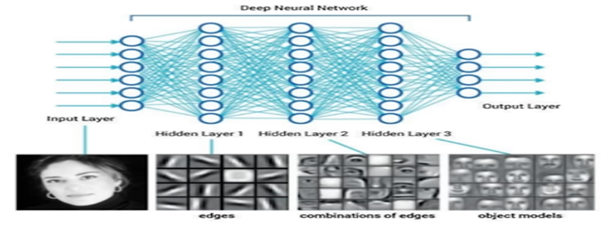
Neural Networks & Deep Learning

Slide 25
What is Reinforcement Learning (RL)?
A branch of machine learning where an agent learns to make decisions by interacting with an environment to maximize a reward.
Inspired by behavioral psychology, RL focuses on trial-and-error learning.
Key Components of Reinforcement Learning
Agent: The decision-maker (e.g., a robot, software, or algorithm).
Environment: The world with which the agent interacts (e.g., a game, a simulation, or the real world).
State (S): The current situation of the environment (e.g., position on a game board).
Action (A): A choice made by the agent (e.g., moving left or right).
Reward (R): Feedback from the environment after an action (e.g., points scored in a game).
Policy (π): A strategy that the agent follows to decide actions based on states.
Value Function (V): Measures the long-term reward of being in a state and following a policy.
How Reinforcement Learning Works
The agent observes the current state of the environment.
It chooses an action based on its policy.
The environment responds by transitioning to a new state and giving a reward.
The agent updates its policy to improve future decisions.
Approaches in Reinforcement Learning
Model-Based RL:
The agent builds a model of the environment to predict outcomes.
Model-Free RL:
The agent learns directly from interactions without modeling the environment.
Includes:
Q-Learning (Off-Policy).
SARSA (On-Policy).
Applications of Reinforcement Learning
Robotics: Training robots to perform tasks autonomously.
Gaming: Achieving superhuman performance (e.g., AlphaGo, OpenAI Five).
Finance: Portfolio optimization and trading strategies.
Healthcare: Personalized treatment plans.
Self-Driving Cars: Decision-making in dynamic environments.

Slide 26
The "AI Paradox"
AI models are getting smarter, but do we really understand them?
The rise of black-box AI vs. the need for Explainability (XAI)
Data Science 2.0 – From predictive analytics to Causal AI & Green AI
Challenge: Can AI truly "think," or is it just pattern recognition at scale?
Why This Matters? Data science isn’t just about coding—it’s about solving real problems at scale.

Slide 27
The rise of black-box AI vs. the need for Explainability (XAI) Interpretability vs. Performance
Problem Statement
High-performing AI models (e.g., Deep Learning) act as 'black boxes'—their decisions are hard to explain, even when accurate
The Paradox
As models grow more complex and accurate, they become less interpretable, raising risks in critical fields (healthcare, finance, justice)
Solutions
1. Explainable AI (XAI)
SHAP: Quantifies feature importance for predictions.
LIME: Explains individual predictions via simplified local models.
2. Human-in-the-Loop Systems
Humans validate/intervene in AI outputs (e.g., doctor + diagnostic AI).

Slide 28
Data Science 2.0 – From predictive analytics to Causal AI & Green AI
The Data Science Journey:
"What will happen?“
Methode: Regression, classification, forecasting;
1.0 (Predictive):
2.0 (Next Gen):
Causal AI:
Why does it happen?“
Beyond Correlation → Causation
Not just patterns, but root causes
Green AI:
At what environmental cost?"
"Performance per watt matters"
Techniques:
Model pruning
Quantization
Efficient architectures
Example: "Reducing BERT's energy use by 60% with minimal accuracy loss"

Slide 29
Data Science 2.0 – From predictive analytics to Causal AI & Green AI
Problem Statement
While modern AI delivers powerful predictions, its inability to explain causality and its unsustainable energy demands limit real-world impact.
The Paradox
The better AI performs, the less we understand it – and the more it costs the planet.
- the more we need human expertise to understand causes
Solutions
1. Causal AI "From What to Why" • Structural Causal Models - Map cause-effect relationships • Do-Calculus - Test interventions before implementation • Example: Healthcare AI that identifies actionable lifestyle changes (not just correlations)
2.Green AI • Model Compression - Pruning, quantization, distillation • Efficient Architectures - Sparse models, neuromorphic computing • Example: 70% smaller BERT model with <1% accuracy drop
3. Hybrid Governance- • XAI Frameworks - SHAP, LIME for decision audits • Ethical Review Boards - Domain experts + AI oversight • Example: Radiologist + AI diagnostic co-validation systems

Slide 30
Challenge: Can AI truly "think," or is it just pattern recognition at scale?
Problem Statement
AI excels at identifying patterns but struggles to understand context, causation, or reasoning—key elements of human thought.
The Paradox
Powerful but Limited: AI can diagnose diseases or write essays, but it lacks true understanding.Example: AI predicts patient readmissions but can’t explain why or suggest actionable interventions.
Solutions
Causal AI: Moves beyond patterns to uncover why things happen (e.g., medication adherence reduces readmissions).
Green AI: Ensures smarter, sustainable models for real-world usability.
Hybrid Governance: Combines AI insights with human expertise for reliable decision-making.

Slide 31
The Core Foundations: A New Lens on Data Science
🔹 From Classical to Quantum AI – The next frontier of computing 🔹 Self-Optimizing Algorithms & AutoML – When AI programs itself 🔹 Data Engineering for Extreme Scale – Beyond Big Data: Smart Data & Data-Centric AI
🔹 The AI Bias Dilemma – How data science reinforces inequality (and how to fix it!)
What’s the most dangerous AI decision-making failure?

Slide 32
The Real-World Impact of Data Science
✅ FinTech & Sustainable Finance – AI predicting the next financial crisis? ✅ AI for Climate Science – Modeling the planet’s future with Data Science ✅ Digital Twins & Synthetic Data – Simulating reality to test the impossible ✅ AI in Social Good – Can algorithms help reduce inequality & fight misinformation?
Which data-driven industry will be disrupted next?

Slide 33
Future-Proofing Your Research: The Data Scientist 2030
🔹 The FAIR Data Movement – Findable, Accessible, Interoperable, Reusable 🔹 Trustworthy AI & EU AI Act – The regulations shaping the future 🔹 The Rise of Causal AI & Hybrid Intelligence – Humans + Machines working together 🔹 Interdisciplinary Data Science – What if an economist, biologist & AI expert team up?

Slide 34
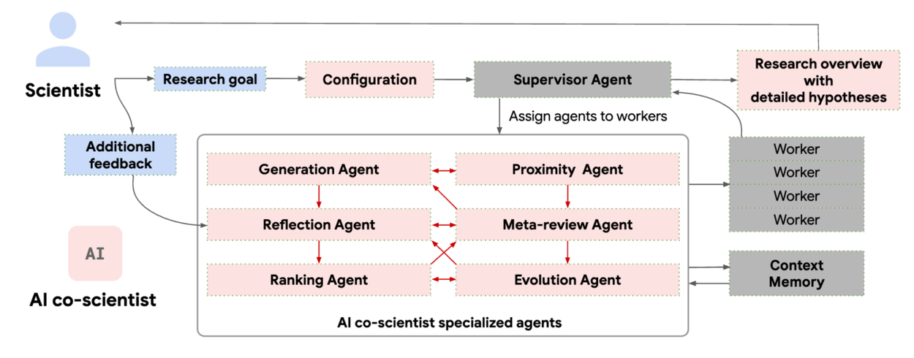
The Collaboration Between Scientists and AI Co-Scientists

Slide 35
Thanks!
Questions?

Slide 36
References

Slide 37
Readings that shaped and inspired the development of the course
Angwin, J., et al. (2016). Machine bias. ProPublica. https://www.propublica.org/article/machine-bias-risk-assessments-in-criminal-sentencing
Box, G. E. P., Jenkins, G. M., Reinsel, G. C., & Ljung, G. M. (2015). Time Series Analysis: Forecasting and Control (5th ed.). Wiley.
Cormen, T. H., Leiserson, C. E., Rivest, R. L., & Stein, C. (2009). Introduction to algorithms (3rd ed.). MIT Press.
Dasu, T., & Johnson, T. (2003). Exploratory data mining and data cleaning. Wiley-Interscience.
Dellermann, D., Calma, A., Lipusch, N., Weber, T., Weigel, S., & Ebel, P. (2021). The future of human-AI collaboration: A taxonomy of design knowledge for hybrid intelligence systems. Proceedings of the 54th Hawaii International Conference on System Sciences. https://hdl.handle.net/10125/71139
Dellermann, D., et al. (2019). Hybrid intelligence. Business & Information Systems Engineering, 61(5), 637–643. https://doi.org/10.1007/s12599-019-00595-2
European Commission. (2024). Regulation on harmonised rules on artificial intelligence (AI Act). Official Journal of the European Union. https://eur-lex.europa.eu/eli/reg/2024/1689
Goodfellow, I., Pouget-Abadie, J., Mirza, M., Xu, B., Warde-Farley, D., Ozair, S., Courville, A., & Bengio, Y. (2020). Generative adversarial networks. Communications of the ACM, 63(11), 139–144. https://doi.org/10.1145/3422622
Goodfellow, I., Bengio, Y., & Courville, A. (2016). Deep Learning. MIT Press. https://www.deeplearningbook.org
Grus, J. (2019). Data science from scratch: First principles with Python (2nd ed.). O’Reilly Media.
Holzinger, A., et al. (2022). Toward human-AI partnerships in clinical decision-making. Nature Digital Medicine, 5(1), 1–10.
Kitano, H. (2021). Nobel Turing Challenge: Creating the engine for scientific discovery. AI Magazine, 42(1), 105-109.
LeCun, Y., Bengio, Y., & Hinton, G. (2015). Deep learning. Nature, 521(7553), 436-444. https://doi.org/10.1038/nature14539

Slide 38
Koopman, P. (2020). How safe is safe enough? Measuring and predicting autonomous vehicle safety. Carnegie Mellon University.
Marcus, G. (2020). The next decade in AI: Four steps towards robust artificial intelligence. arXiv preprint. https://arxiv.org/abs/2002.06177
Moore, D. S., McCabe, G. P., & Craig, B. A. (2017). Introduction to the practice of statistics (9th ed.). W. H. Freeman.
National Academies of Sciences. (2022). Convergence: Facilitating transdisciplinary integration of life sciences, physical sciences, engineering, and beyond. National Academies Press. https://doi.org/10.17226/26322
Parikh, R. B., & Helmchen, L. A. (2022). Paying for artificial intelligence in medicine. npj Digital Medicine, 5, 63. https://doi.org/10.1038/s41746-022-00609-6
Pearl, J. (2019). The limitations of black-box models and the need for causal reasoning. Journal of Artificial Intelligence Research, 64, 247–254.
Pearl, J., & Mackenzie, D. (2018). The book of why: The new science of cause and effect. Basic Books.
Provost, F., & Fawcett, T. (2013). Data science for business: What you need to know about data mining and data-analytic thinking. O’Reilly Media.
Schwartz, R., Dodge, J., Smith, N. A., & Etzioni, O. (2020). Green AI. Communications of the ACM, 63(12), 54–63. https://doi.org/10.1145/3381831
Strubell, E., Ganesh, A., & McCallum, A. (2020). Energy and policy considerations for modern deep learning research. Proceedings of the AAAI Conference on Artificial Intelligence, 34(09), 13693–13696. https://doi.org/10.1609/aaai.v34i09.7123
Tukey, J. W. (1977). Exploratory data analysis. Addison-Wesley.
Russell, S., & Norvig, P. (2021). Artificial Intelligence: A Modern Approach (4th ed.). Pearson.
Savage, N. (2022). AI co-pilots for scientists. Nature, 606(7914), 220-223. https://doi.org/10.1038/d41586-022-01612-3
Wilkinson, M. D., et al. (2016). The FAIR Guiding Principles for scientific data management and stewardship. Scientific Data, 3(1), 160018. https://doi.org/10.1038/sdata.2016.18
Wooldridge, M. (2009). An Introduction to Multi-Agent Systems (2nd ed.). Wiley.
Waskom, M. (2021). Seaborn: Statistical data visualization. Journal of Open Source Software, 6(60), 3021.
Wasserman, L. (2004). All of statistics: A concise course in statistical inference. Springer.
Zaharia, M., Chowdhury, M., Franklin, M. J., Shenker, S., & Stoica, I. (2016). Apache Spark: A unified engine for big data processing. Communications of the ACM, 59(11), 56–65.
Zanzotto, F. M. (2020). Viewpoint: Human-in-the-loop artificial intelligence. Communications of the ACM, 63(3), 33–35. https://doi.org/10.1145/3361125
Zheng, A., & Casari, A. (2018). Feature engineering for machine learning: Principles and techniques for data scientists. O’Reilly Media.

Slide 39
IBM. (n.d.). What is Artificial Intelligence (AI)?. IBM Cloud Learn Hub. https://www.ibm.com/cloud/learn/what-is-artificial-intelligence
Google AI. (2020). Machine Learning Education. https://ai.google/education
https://azure.microsoft.com/en-gb/resources/cloud-computing-dictionary/what-is-data-science/
https://eng.libretexts.org/Bookshelves/Data_Science/Principles_of_Data_Science_(OpenStax)/01%3A_What_Are_Data_and_Data_Science/1.01%3A_What_Is_Data_Science
https://www.youtube.com/watch?v=0YdpwSYMY6I
https://www.youtube.com/watch?v=E0Hmnixke2g
https://www.youtube.com/@programmingwithmosh

